Slide 1
Library of Client-Ready DFA Slides
Q3 2023
Compiled from Dimensional Fund Associates
By
Stephen J. Huxley, Ph.D.
Director of Research, Asset Dedication LLC
huxleys@assetdedication.com

Slide 2
Instructions
The purpose of this library is to assist advisors associated with Asset Dedication. It was developed entirely from the collection of “client-ready” slides provided by Dimensional Fund Associates. Users can pick and choose whichever slides they wish to explain various investing concepts to end-clients. Any time a slide is selected, the accompanying “Disclosure” slide that follows it should be included for compliance purposes. Please review the Content Use Guidelines on the last slide.

Slide 3
List of Slides:
Long Term: 1926/27 – 2021/22
  Bulls, Bears, and Long-Term Benefits of Stock Investing
  The Bumpy Road to the Market’s Long-Term Average
  Stock Gains Can Add Up after Big Declines
  The Rewarding Distribution of US Stock Market Returns
  Why a Stock Peak Isn’t a Cliff
  Think Twice About Chasing the Biggest Stocks
  How Often Do Small Cap, Value, and High Profitability Outperform?
  Long-Term Investors, Don’t Let a Recession Faze You
  What History Tells Us about US Presidential Elections and the Market
  How US Stocks Have Behaved in an Election Month (Presidential)
  What History Tells Us about the Market and Control of US Congress

Slide 4
List of Slides:
Shorter term – Various time periods:
  Will Inflation Hurt Stock Returns? Not Necessarily. (1993-2022)
  The Cost of Trying to Time the Market (1997-2022)
  Do Downturns Lead to Down Years? (2002-2022)
  The Randomness of Global Stock Returns (2003-2022)
  Markets Don’t Wait for Official Announcements (2007-2010)
  Global Diversification Can Make a World of Difference (2022)
  Why Trade with Yourself? Core Funds Can Solve That Problem (2022)

Slide 5
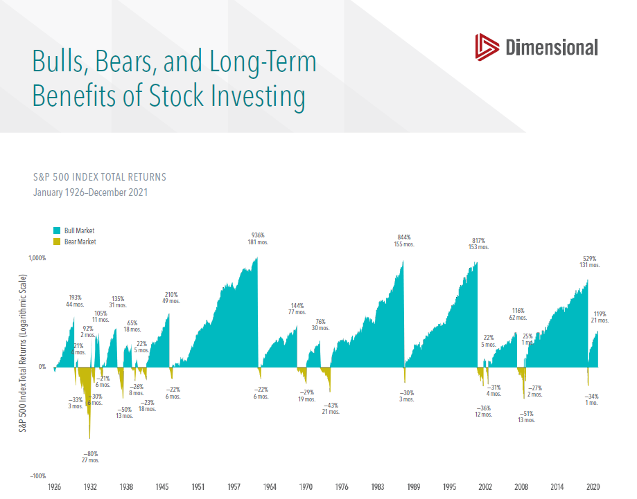
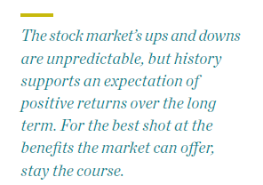
https://my.dimensional.com/one-pagers/bulls-bears-and-long-term-benefits-of-stock-investing

Slide 6
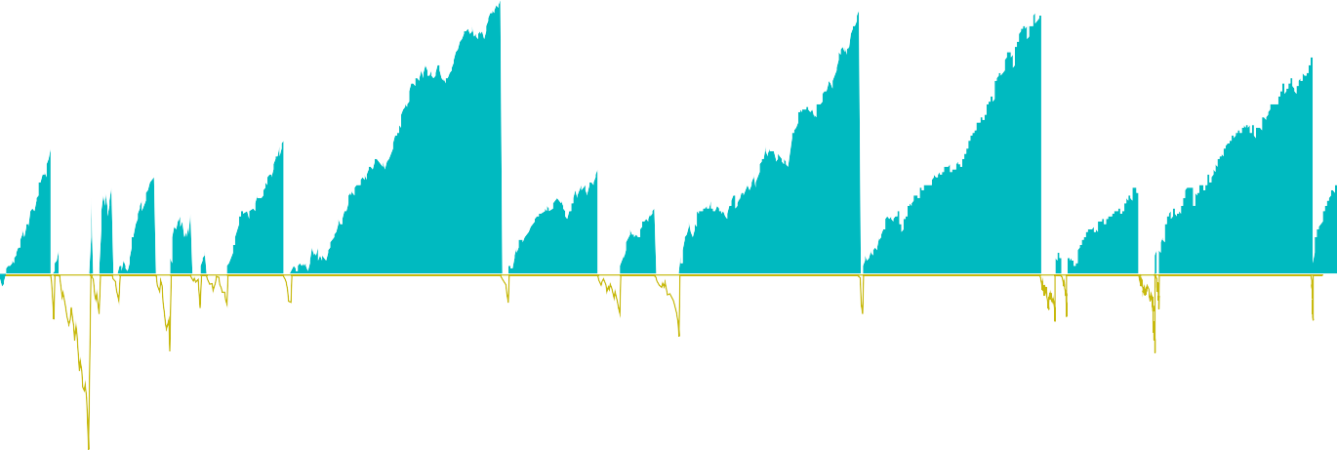
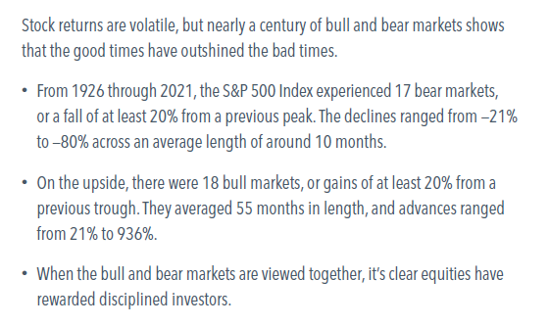

Slide 7
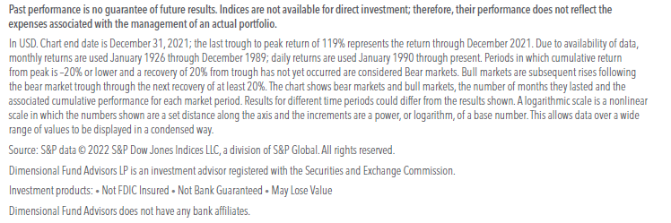
Disclosures

Slide 8
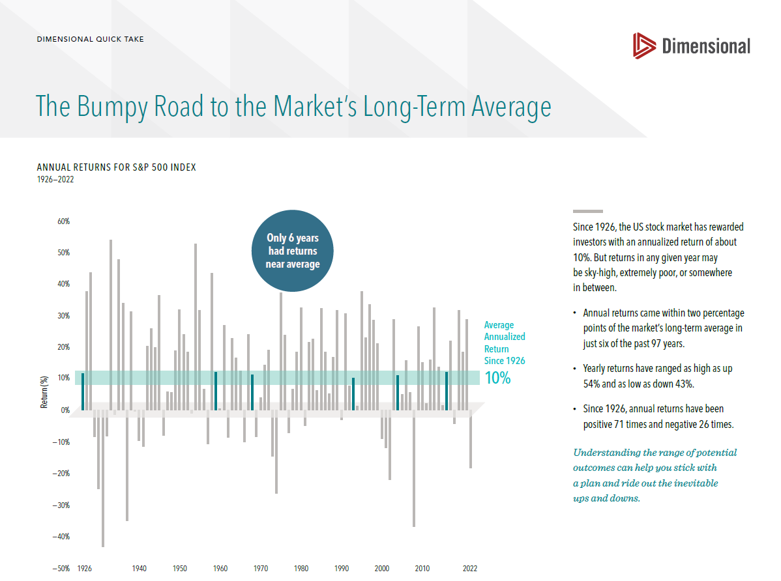
https://my.dimensional.com/one-pagers/the-bumpy-road-to-the-markets-long-term-average

Slide 9
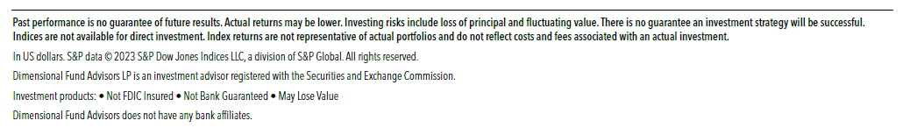
Disclosures

Slide 10
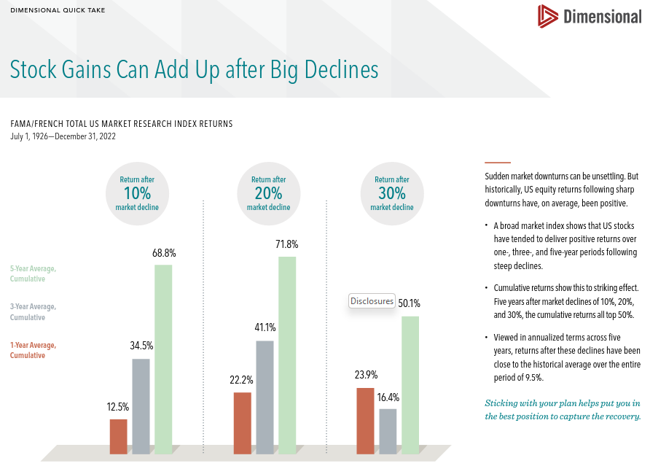
https://my.dimensional.com/one-pagers/history-shows-that-stock-gains-can-add-up-after-big-declines

Slide 11
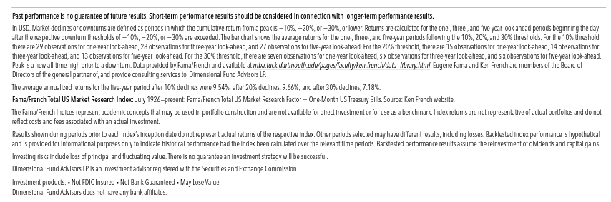
Disclosures

Slide 12
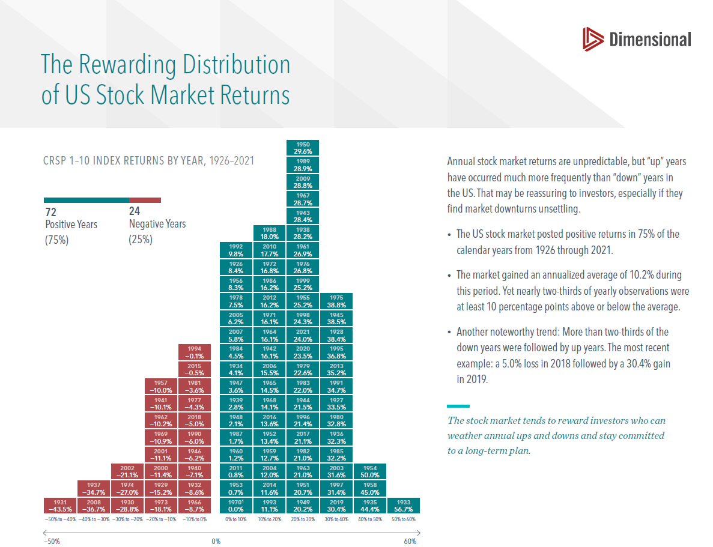
https://my.dimensional.com/one-pagers/the-rewarding-distribution-of-us-stock-market-returns

Slide 13
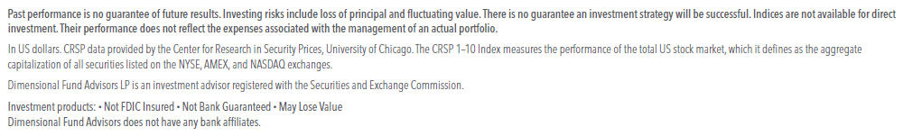
Disclosures

Slide 14
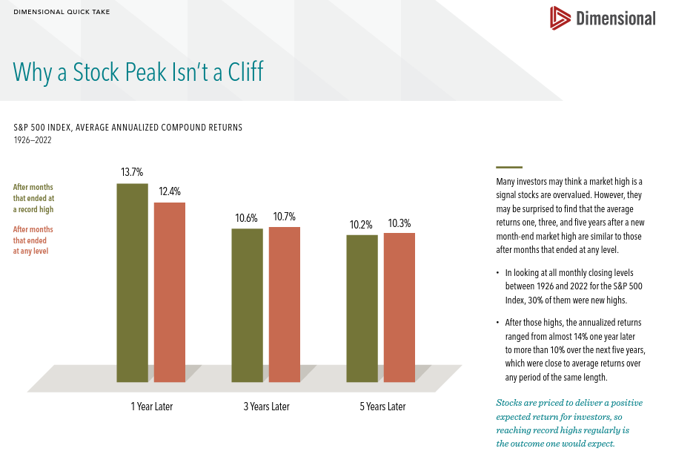
https://my.dimensional.com/one-pagers/why-a-stock-peak-isnt-a-cliff

Slide 15
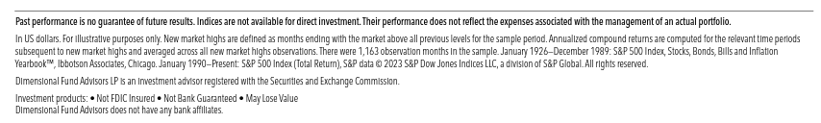
Disclosures

Slide 16
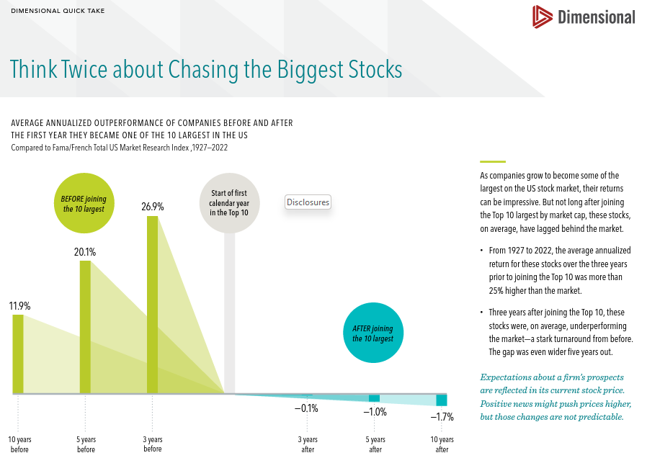
https://my.dimensional.com/one-pagers/why-investors-might-think-twice-about-chasing-the-biggest-stocks

Slide 17
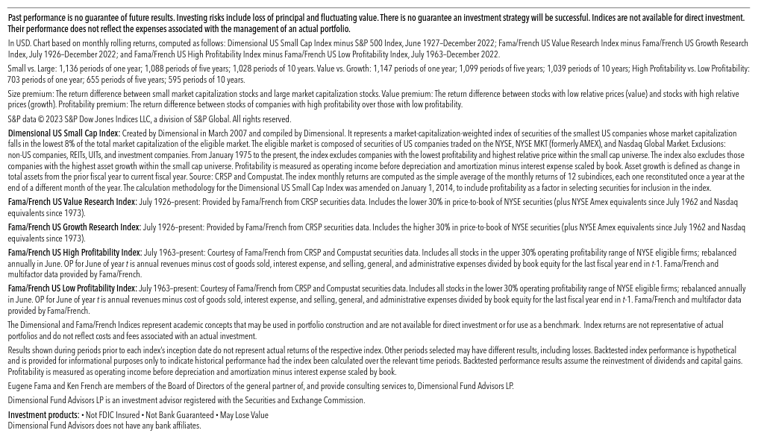
Disclosures

Slide 18
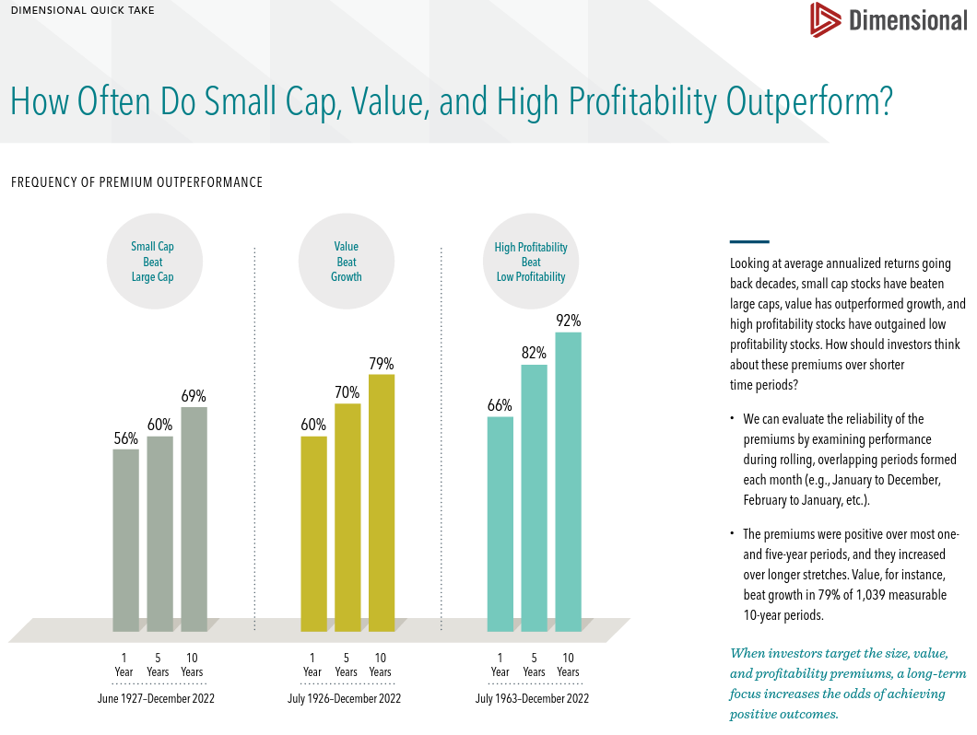
https://my.dimensional.com/one-pagers/how-often-do-small-cap-value-and-high-profitability-outperform

Slide 19
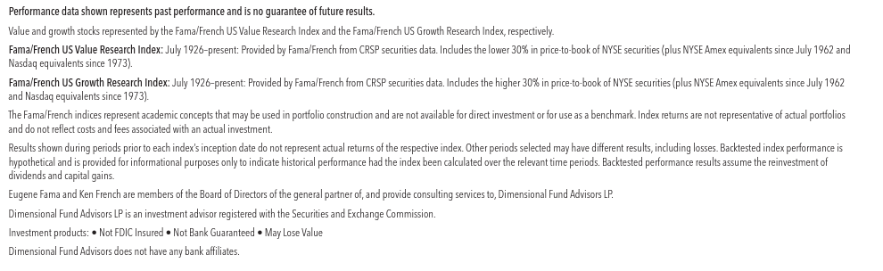
Disclosures

Slide 20
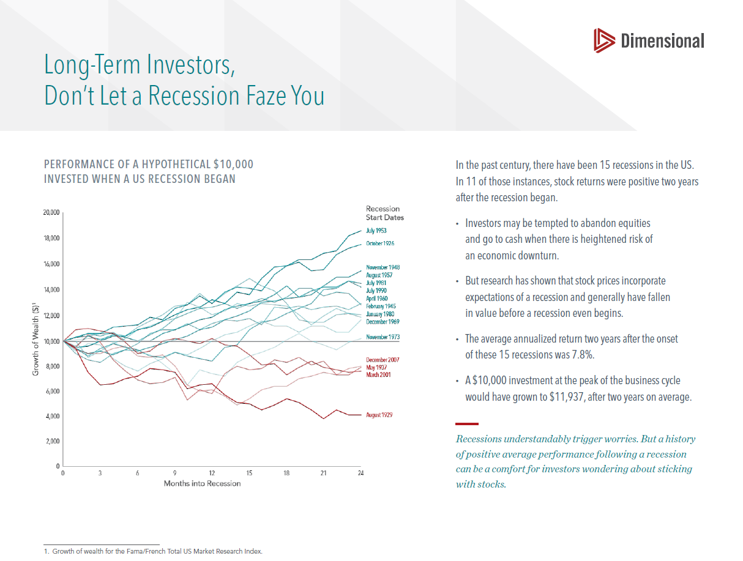
https://my.dimensional.com/one-pagers/long-term-investors-dont-let-a-recession-faze-you

Slide 21
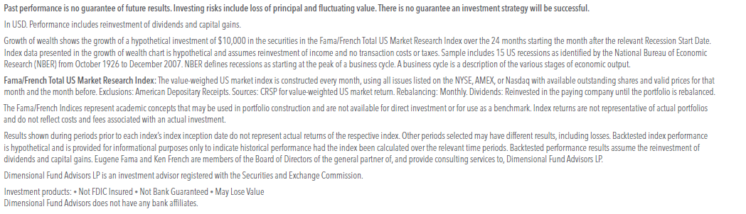
Disclosures

Slide 22
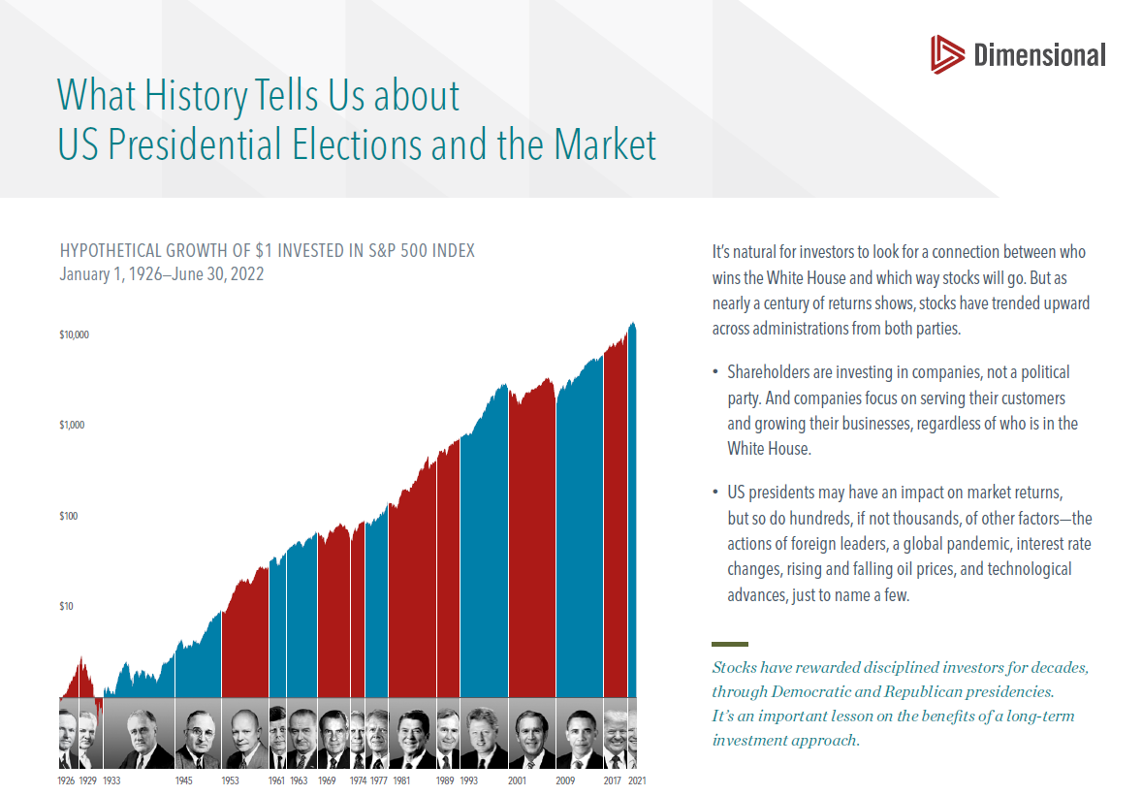
https://my.dimensional.com/one-pagers/what-history-tells-us-about-us-presidential-elections-and-the-market

Slide 23
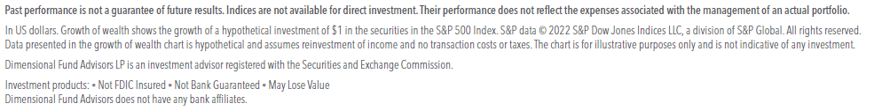
Disclosures

Slide 24
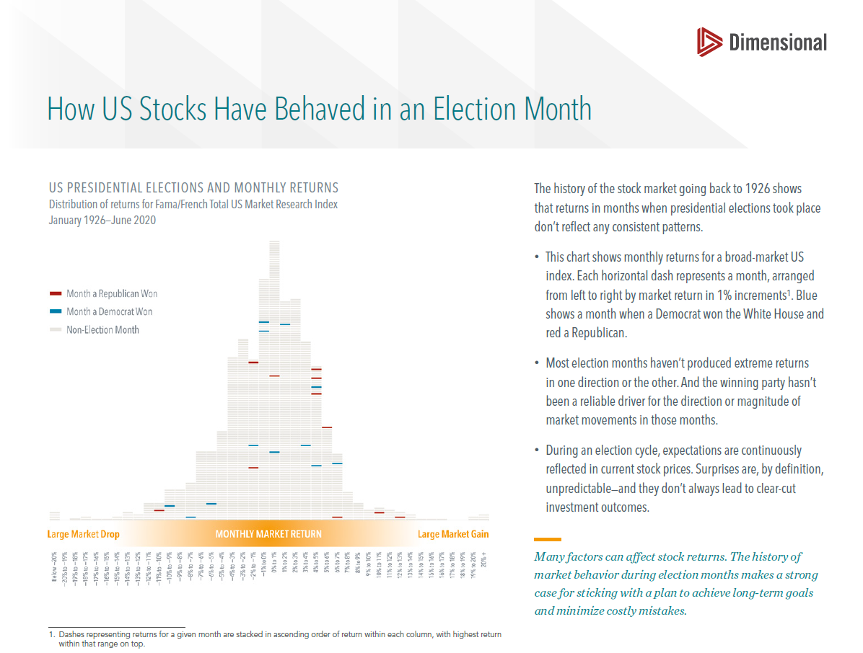
https://my.dimensional.com/one-pagers/how-us-stocks-have-behaved-in-an-election-month

Slide 25
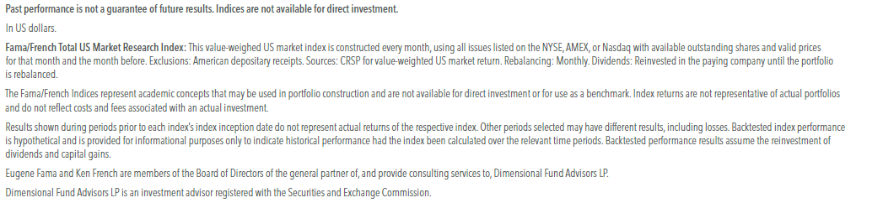
Disclosures

Slide 26
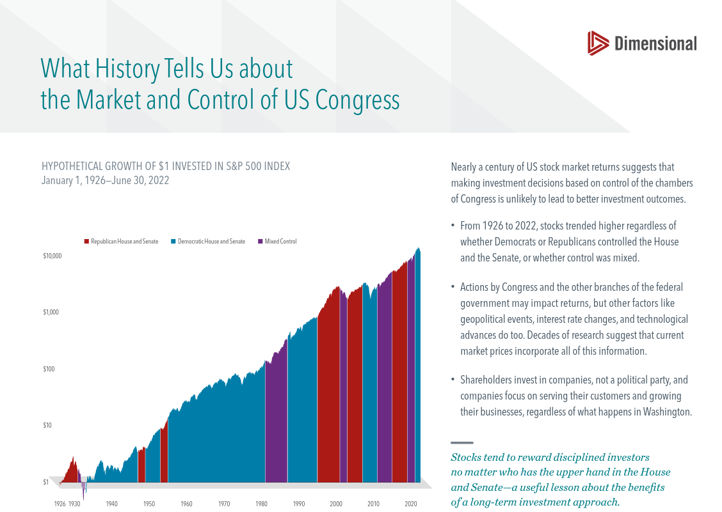
https://my.dimensional.com/one-pagers/what-history-tells-us-about-the-market-and-control-of-us-congress

Slide 27
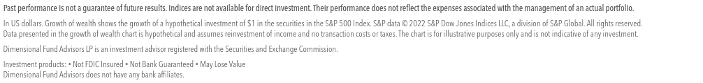
Disclosures

Slide 28
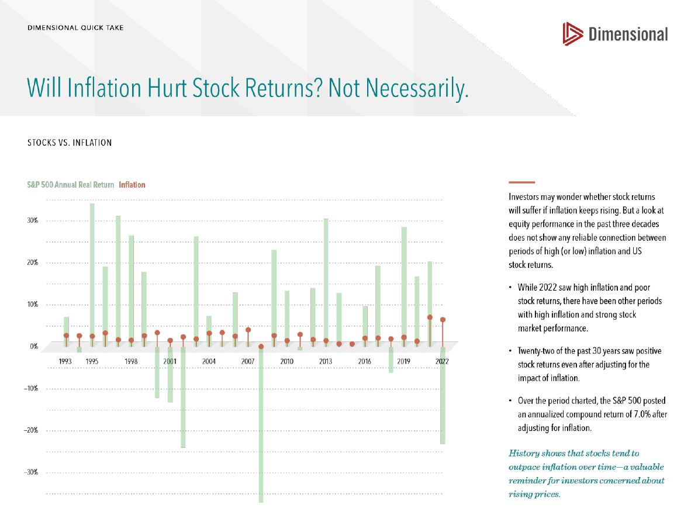
https://my.dimensional.com/one-pagers/will-inflation-hurt-stock-returns-not-necessarily

Slide 29
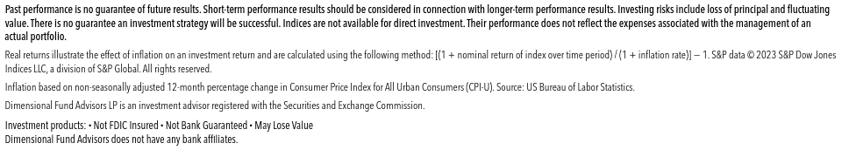
Disclosures

Slide 30
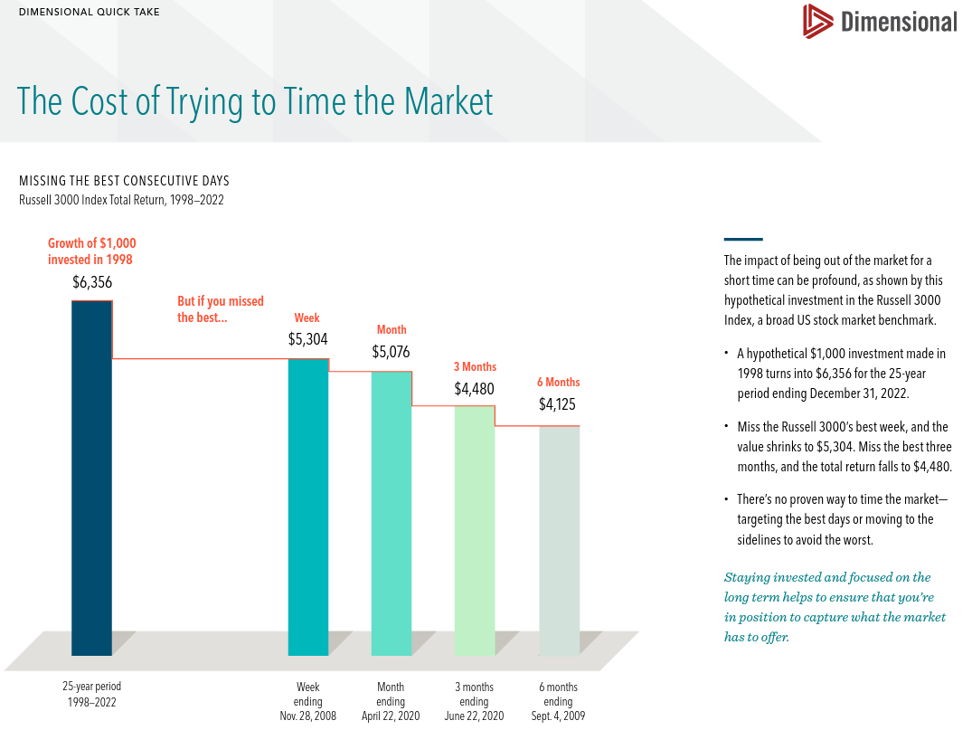
https://my.dimensional.com/one-pagers/the-cost-of-trying-to-time-the-market

Slide 31
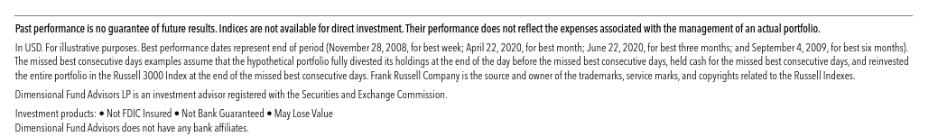
Disclosures

Slide 32
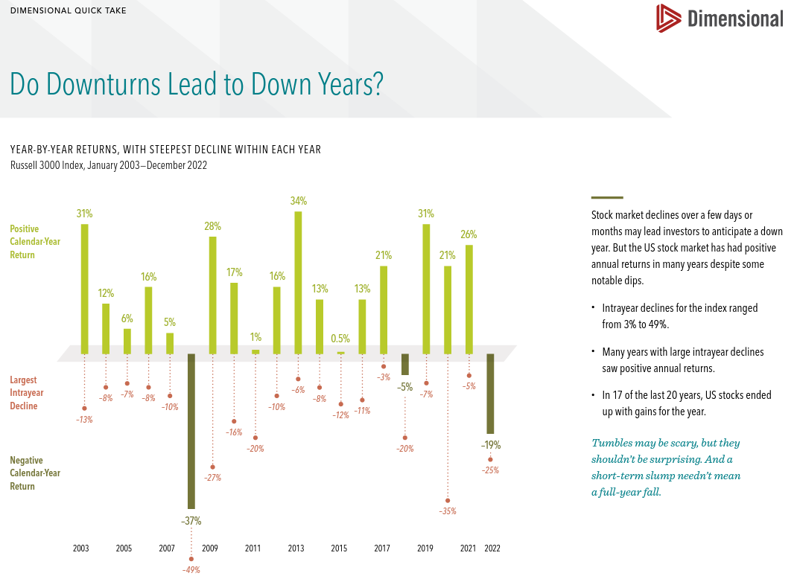
https://my.dimensional.com/one-pagers/do-downturns-lead-to-down-years

Slide 33
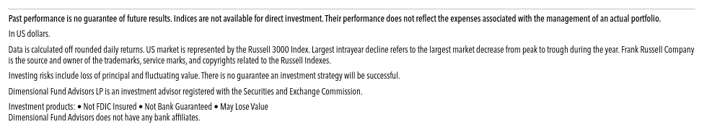
Disclosures

Slide 34
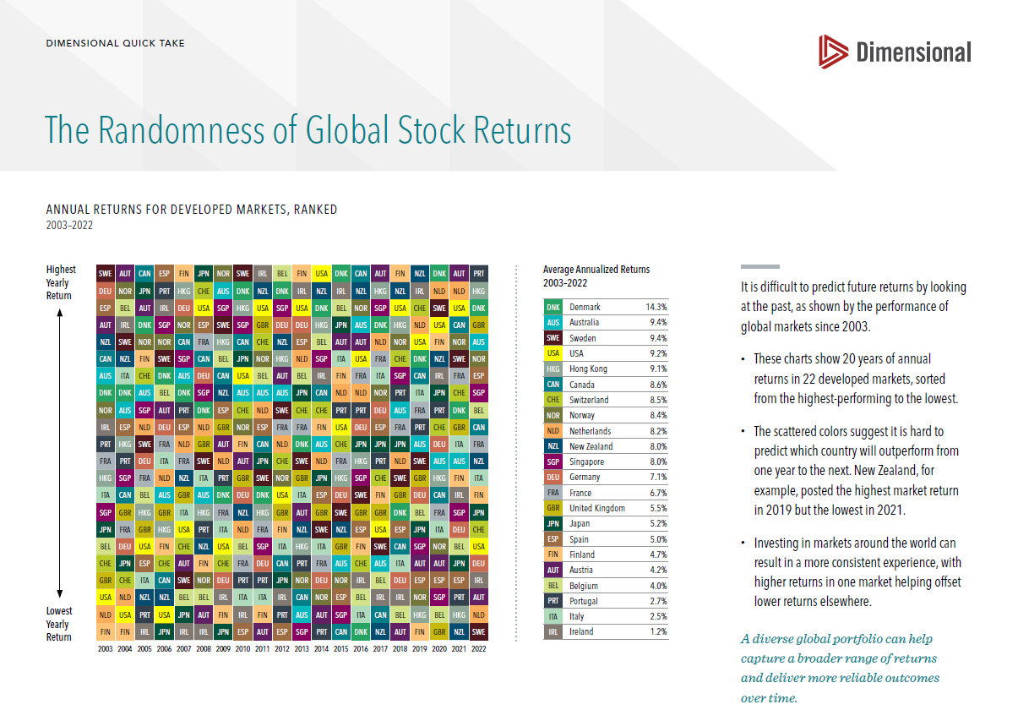
https://my.dimensional.com/one-pagers/the-randomness-of-global-stock-returns

Slide 35
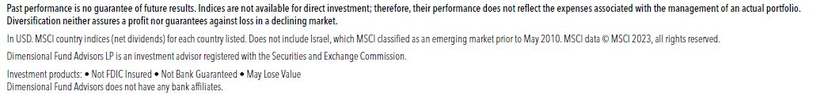
Disclosures

Slide 36
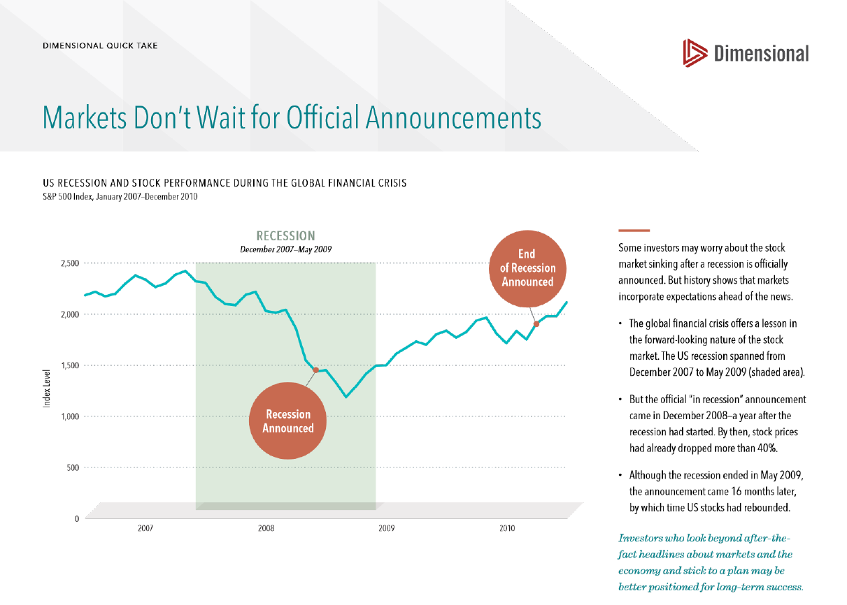
https://my.dimensional.com/one-pagers/markets-dont-wait-for-official-announcements

Slide 37
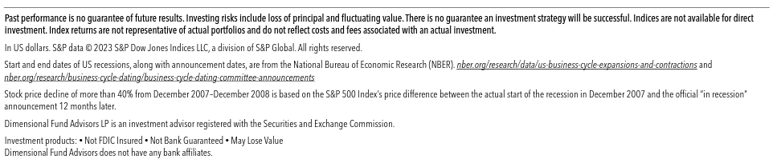
Disclosures

Slide 38
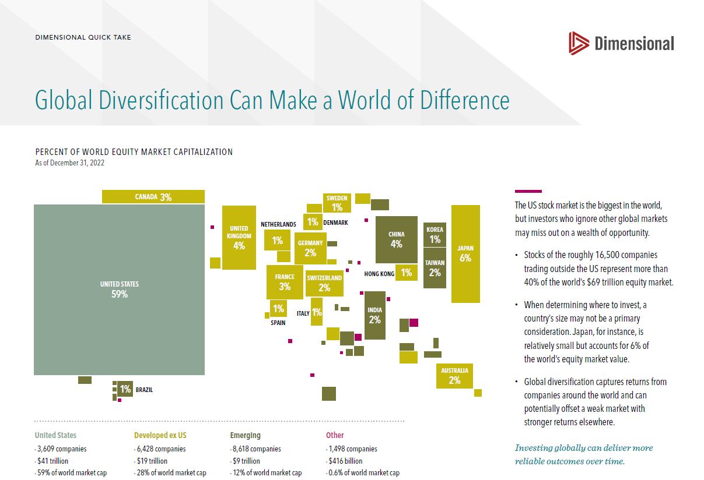
https://my.dimensional.com/one-pagers/global-diversification-can-make-a-world-of-difference

Slide 39
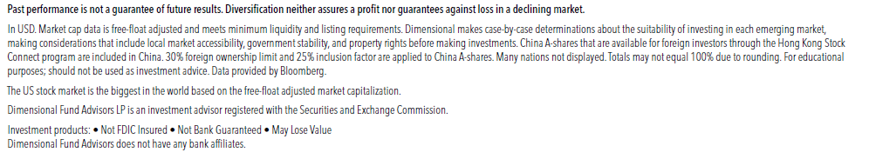
Disclosures

Slide 40
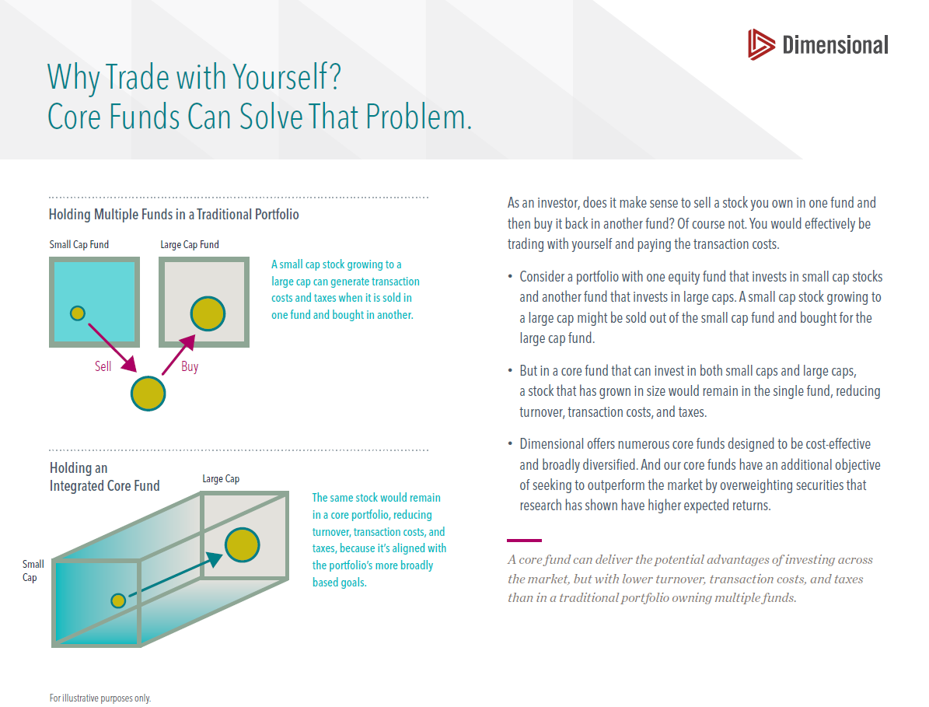
https://my.dimensional.com/one-pagers/why-trade-with-yourself-core-funds-can-solve-that-problem

Slide 41
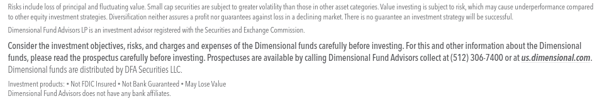
Disclosures

Slide 42

